Slide 1
Module 5 Guidance Notes Functions
COMP2113 Programming Technologies
ENGG1340 Computer Programming II

Slide 2
Before We Start
We will still deal with C++ only in this module.
Important: We will be using the C++ 11 standard, so make sure that your compiler option is set appropriately. We suggest to use the following command to compile your C++ program:
g++ -pedantic-errors -std=c++11 your_program.cpp
The -pedantic-errors flag is to make sure that your code conforms to the ISO C/C++ standard. We will enforce this in your assignment submission too. For more information about C/C++ standards, you may read https://en.wikipedia.org/wiki/ANSI_C and https://isocpp.org/std/the-standard
<number>

Slide 3
How to Use this Guidance Notes
This guidance notes aim to lead you through the learning of the C/C++ materials. It also defines the scope of this course, i.e., what we expect you should know for the purpose of this course. (and which should not limit what you should know about C/C++ programming.)
Use “Presentation Mode” in PowerPoint to go through the slides since animations are incorporated which may enhance the flow of reading
Pages marked with “Reference Only” means that they are not in the scope of assessment for this course.
<number>

Slide 4
How to Use this Guidance Notes
The corresponding textbook chapters that we expect you to read will also be given. The textbook may contain more details and information than we have here in this notes, and these extra textbook materials are considered references only.
We suggest you to copy the code segments in this notes to the coding environment and try run the program yourself.
Also, try make change to the code, then observe the output and deduce the behavior of the code. This way of playing around with the code can help give you a better understanding of the programming language.
<number>

Slide 5
What are we going to learn?
Top-down design (divide and conquer) approach
Functions definition
Function call
Function declaration
Scope of Variables
Parameters passing mechanism
Pass-by-value
Pass-by-reference
<number>
Notes:
<number>

Slide 6
Recommended Readings
You may want to check out the following supplementary readings:
Book Chapters
Problem Solving with C++
Ch. 4.1 – 4.5
Ch. 5.1 – 5.4
From C++ tutorials
Functions
Variable Scope
<number>

Slide 7
Top-down design (divide and conquer) approach
<number>

Slide 8
Top-Down Program Design
A good way to design a program is to break down the task to be accomplished into a few sub-tasks
Each sub-task can be further decomposed into smaller sub-tasks, and this process is repeated until all sub-tasks are small enough that their implementations become manageable
This approach is called top-down design (a.k.a. divide and conquer)
<number>

Slide 9
Top-Down Design
Example: Compute the final score for a student
Simple GPA Calculator
Read in data
Compute GPA
Output result to screen
Convert marks to grade and grade point
Compute sum of weighted grade points
Compute sum of credit units
Compute GPA and round up the result to 2 decimal places
Each module should perform a single, well-defined task
<number>
Notes:
<number>

Slide 10
Functions
Preserving the top-down design structure in a program will make it easier to understand and modify the program, as well as to write, test, and debug the program
In C++, sub-tasks are implemented as functions
A function is a group of statements that is executed when it is called from some point of the program
E.g., the main function main() in previous examples
A program is composed of a collection of functions
When a program is put into execution, it always starts at the main function, which may in turn call other functions
<number>

Slide 11
Advantages of Using Functions
May focus on a particular task, easy to construct and debug
Different people can work on different functions simultaneously
A function is written once and can be reused multiple times in a program or in different programs
Improve readability of a program by reducing the complexity of main()
<number>

Slide 12
Predefined Functions
Some computations and operations are so common that they are implemented as pre-defined functions that are shared for use
Consider computing the square root of a number. It would be nice if we have a black box function (i.e., we don’t care how the computation is done) to help us do the calculation.
All that you need to know to use a predefined function is:
what is required for the computation (i.e., function input); and
what is the result of the computation (i.e., function output)
e.g.
double x = sqrt(5.29);
Here, 5.29 is the function input and the function output 2.3 would be stored to x
<number>

Slide 13
Predefined Functions
C++ comes with libraries of pre-defined functions that programmers can use in their programs. A library contains
Function definitions (i.e., codes containing the body of a function for doing the actual computations) that are stored in separate files and have been pre-compiled into object codes for further linking
Function declarations (i.e., what a function accepts as input and returns as output) that are stored in files known as the header files
<number>

Slide 14
Examples
Some commonly used predefined functions. It means that you can make use of them in your program for a particular task(e.g., computing the square root of a number) without the need of writing that part of the code on your own.
Always consult the C++ manuals, e.g. www.cplusplus.com, for the details of individual functions.
The file containing all the function declarations
Function declarations | Description | Library Header
double sqrt(double x) | Square root of x | cmath
double pow(double x, double y) | x to the power of y (i.e., x^{y}) | cmath
double fabs(double x) | Absolute value of x | cmath
double ceil(double x) | Round up the value of x | cmath
double floor(double x) | Round down the value of x | cmath
int abs(int x) | Absolute value of x | cstdlib
int rand() | A random integer | cstdlib
<number>

Slide 15
Using Predefined Functions
It is very important for a developer to be able to use predefined functions, since there are many libraries out there already well-written (and well-tested) by others for some specific purposes, e.g., math libraries, image handling libraries, linear algebra libraries.
The function declarations in the header files should tell how we may use each function in the given library, but usually we will go to the library documentation (or manual/reference) to look at the usage details for each function.
It is therefore also very important for a developer to be able to read and understand library documentation.
<number>

Slide 16
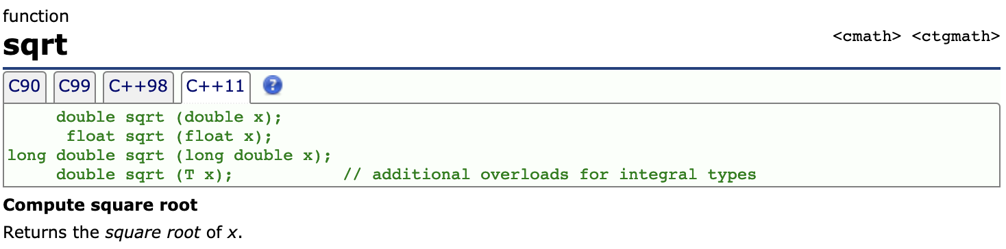
Function Reference Example
This is what you can find from the sqrt() function reference from cplusplus.com:
This is the different C++ version, so we’ll use C++11
Header file containing the function declaration of this function
Function name
input parameter data type
output data type
Describes what the function does and what it outputs
Note that a function may accept different data types as inputs (hence there are 4 different function declarations for sqrt()). This is called function overloading.
In this case, if you provide a double type input to sqrt(), the output returned by the function will be of a double type, if the input to sqrt() is of a float type, then the output would be of a float type.
Check this for some examples in function overloading.
<number>
Notes:
<number>

Slide 17
Using Predefined Functions
To use a pre-defined function, simply include the corresponding header file using the include directive #include <…> at the beginning of the file containing your code
e.g., #include<iostream> for using cin, cout, endl
e.g., #include<cstdlib> for using rand(), srand()
This step is mandatory so that the compiler can check if the functions are used correctly. Recall that the header contains how the functions should be used.
To use a predefined function, read its function reference and take note of the input parameters and the return type for a function and make the function call accordingly.
<number>

Slide 18
Using Predefined Functions
Include <cmath> so you can use the pow() and sqrt() functions from the math library later on in the same program file.
#include <iostream> #include <cmath>
using namespace std;
int main() {
// Compute the root mean square of 10 input numbers
int i;
double n, sq_sum = 0;
for(i=0; i<10; i++)
{
cout << i+1 << ": ";
cin >> n;
sq_sum += pow(n, 2.0);
}
cout << "The root mean square is " << sqrt(sq_sum/10) << endl;
return 0;
}
Example:
A function may accept one or more input parameters. The order and type of each parameter matter. Check the pow() reference page to see what each parameter mean.
<number>

Slide 19
Example: Random Number Generation
We need random numbers under many circumstances, e.g., games in which we need to generate random scenarios for the players.
#include <iostream>
using namespace std;
int main()
{
int num = 23;
int guess;
bool isGuessed;
isGuessed = false;
while (!isGuessed) {
cout << "Make a guess (0-99)? ";
cin >> guess;
if (guess == num) {
cout << "Correct!" << endl;
isGuessed = true;
}
else if (guess < num)
cout << "Too small. Guess again!" << endl;
else
cout << "Too large. Guess again!" << endl;
}
return 0;
}
Recall the simple number guessing game in slide 112 of Module 3.
We can see that the answer is always 23 no matter how many times you run the program, as this “answer” is hard-coded into the program. This is not so interesting as a game.
Let’s try add in some randomness for this game by making your program generate a different number randomly every time it is run.
<number>

Slide 20
Example: Random Number Generation
We need the rand() function in <cstdlib> to generate a random number.
http://www.cplusplus.com/reference/cstdlib/rand/
Look at what it returns. The function returns a random integer in the range [0, RAND_MAX], and RAND_MAX is a constant defined in <cstdlib>.
So how can we make use of it for generating a random integer in the range of [0, 9]?
Hint: use the modulus operator %, which computes the remainder of a division.
<number>

Slide 21
Example: Random Number Generation
Q.1 how to generate a random integer in the range of [0, 9]?
Answer:
Q.2 how to generate a random integer in the range of [0, 100]?
Answer:
Q.3 how to generate a random integer in the range of [1, 100]?
Answer:
rand() % 10
rand() % 101
rand() % 100 + 1
<number>

Slide 22
Example: Random Number Generation
Take look at this program. What does it do?
It generates and prints 10 random integers in the range [1,100].
Now, try to run the program. Write down the numbers that it generated.
Run the program again. And again. And again. What do you notice?
#include <iostream>
#include <cstdlib> // needed for calling rand()
using namespace std;
int main()
{
for (int i = 0; i < 10; ++i)
cout << rand() % 100 + 1 << endl;
return 0;
}
<number>

Slide 23
Example: Random Number Generation
The program generates the same 10 numbers for every run. So it’s not that “random” after all. Why is that?
The algorithm for generating the sequence of random numbers depends on an initial ”seed” number. Given the same seed, the same sequence of numbers will be generated. They are “random” in the sense that the distribution of the numbers in the sequence is random.
This is why when you run your program, it always generates the same sequence because we didn’t change the seed.
The seed for the random number generator can be specified by srand() function.
The function return type “void” means the function does not return any value.
<number>

Slide 24
Example: Random Number Generation
So our program should look something like this:
Now what should we fill in for ??? ? The srand() takes a number which will be used as the seed for generating number. But we need a different number every time we run the program.
How about taking the current system time as the seed? In this way, we can guarantee a different runtime value for every program run.
#include <iostream>
#include <cstdlib> // for calling srand(), rand()
using namespace std;
int main()
{
srand(???); // initialize the seed for rand()
for (int i = 0; i < 10; ++i)
cout << rand() % 100 + 1 << endl;
return 0;
}
<number>

Slide 25
Example: Random Number Generation
We need another predefined function to obtain the current system time:
Go to the function reference page and read the details about the parameters and return value, on how to get the current time using this time() function. The function call time(NULL) will return the current time.
Or, look at the example on the reference page for rand() (http://www.cplusplus.com/reference/cstdlib/rand/) and you can see that we can simply initialize the seed for the random number generator with the current time by
time_t is a special data type for integral values representing time
http://www.cplusplus.com/reference/ctime/time/
// initialize random seed
srand(time(NULL));
<number>

Slide 26
Example: Random Number Generation
Now plug all these into our program for generating 10 random numbers:
Run the program again. And again. And again. We are done!
#include <iostream>
#include <cstdlib> // for calling srand(), rand()
#include <ctime> // for calling time()
using namespace std;
int main()
{
srand(time(NULL)); // initialize the seed for rand()
for (int i = 0; i < 10; ++i)
cout << rand() % 100 + 1 << endl;
return 0;
}
<number>

Slide 27
Example: Random Number Generation
Note: It turns out to be very important that we can specify the seed value. Sometimes we do want to have the same sequence of random numbers to be generated for every run of our program, especially for debugging.
Suppose you have a set of random numbers as input to part of your code, then imagine how difficult it would be to debug your program if in every program run, these numbers are different because the behavior of your program would be different. In this case, you may want to fix the random seed, by supply the same number to srand(), such as srand(0).
Now, a quick exercise. Can you modify the guessing game on p.19 so that it will generate a random number (say, from 1 to 50) for the player?
Next, you will start writing your own functions in your program.
<number>

Slide 28
Defining Your Own Functions
Suppose you want to have a function which tells which of the two given floating point numbers is larger.
These are the questions that you should ask (& answer):
Q1. What are the input(s) to the functions? What are their data type?
Q2. What is the output of the function? What is its data type?
Q3. What should be done inside the function to make it work?
Two floating-point numbers, data type: double
One floating-point numbers, data type: double
How do you determine which of the two given numbers are larger?
<number>

Slide 29
Defining Your Own Functions
Let’s give a name to the function: larger
By answering Q1 & Q2, we can come up with the function header
double larger(double x, double y)
return data type
input parameters with data type
The two input numbers will be named x and y inside this function
<number>

Slide 30
Defining Your Own Functions
To answer Q3, we need the actual computations inside the function body:
double larger(double x, double y)
{
double max;
if (x >= y)
max = x;
else
max = y;
return max;
}
function body
embraced by {}
function parameters x and y are used in the calculation
return statement
returns the specified value to the caller
terminates the execution of the function
max is the return value, and its data type must agree with that specified in the function header (i.e., double)
<number>

Slide 31
Function Definition
By now, we have completed the function definition for larger().
return type
function name
list of parameters
double larger(double x, double y)
{
double max;
if (x >= y)
max = x;
else
max = y;
return max;
}
function header
function body
<number>

Slide 32
Function Definition
Formally speaking, a function is defined using a function definition which
Describes how a function computes the value it returns
Consists of a function header followed by a function body
function name
list of parameters (types and names)
type of return value
Syntax
type_ret func_name(type1 par1, type2 par2, …)
{ // variable declarations
…
// executable statements
…
}
function header
function body
embraced by {}
<number>

Slide 33
Function Call
How to call (or invoke) a function?
Think about how you use the pre-specified function sqrt()?
A function call (i.e., the process of calling a function) is made using the function name with the necessary parameters
A function call is itself an expression, and can be put in any places where an expression is expected
Example:
double z = larger(2.5, 5.0);
Return values from larger() after function call is assigned to the variable z
Function name
Parameters as input to function
<number>

Slide 34
Function Call
Parameters vs. arguments
The parameters used in the function definition are called formal parameters or simply parameters. They are placeholders in the function.
The actual values passed to a function in a function call are referred to as actual parameters or arguments. They are the actual values used in the execution of the function to produce the return value.
double larger(double x, double y)
{
…
}
parameters
c = larger ( 2.5, 5.0 );
arguments
<number>

Slide 35
Function Call
The arguments used in a function call can be constants, variables, expressions, or even function calls, e.g.,
In using expressions as arguments, the expressions will be evaluated to produce a value before the function call is made
Since a function call is also an expression, the mechanism of using function calls as arguments is identical to that of using expressions
double z1 = larger (2.5, 5.0); // constants double z2 = larger (one, two); // variables double z3 = larger (one – 2, two); // expressions double z4 = larger (2.5, larger (3, 5.0) ); // a function
<number>

Slide 36
Function Declaration
The compiler needs to know about the function prototype (i.e., its name, input parameters, return type) before a function can be used.
#include <iostream> using namespace std;
double larger(double x, double y)
{ if (x >= y)
return x;
else
return y;
}
int main()
{
….
c = larger(a, b);
….
}
#include <iostream> using namespace std;
double larger(double x, double y);
int main()
{
….
c = larger(a, b);
….
}
double larger(double x, double y)
{ if (x >= y)
return x;
else
return y;
}
Note the ; here. It is needed since this function declaration is a statement. Compare this with the function header in the example on the left.
Alternatively, the function definition can be placed anywhere in the source file by including a function declaration before the function call
One way to do this is to place the function definition before the function call in the source file
<number>

Slide 37
Function Declaration
A function declaration is similar to a function header except that it must be followed by a semicolon; and the identifiers in the parameter list can be changed or even omitted. It provides all the information needed in making a function call.
Syntax
type_ret func_name(type1 par1, type2 par2, …);
or
type_ret func_name(type1, type2, …);
<number>

Slide 38
Function Declaration
Examples:
#include <iostream> using namespace std;
double larger(double p, double q) ;
int main()
{
….
c= larger(a, b);
….
}
double larger(double x, double y)
{ return (x >= y)? x : y;
}
#include <iostream> using namespace std;
double larger(double, double) ;
int main()
{
….
c = larger(a, b);
….
}
double larger(double x, double y)
{ return (x >= y)? x : y;
}
<number>

Slide 39
Function Call - Flow of Control
When a program is put into execution
It always starts at the main function no matter where its definition is in the source file
The statements in the main function are executed sequentially from top to bottom and the control is passed from one statement to another
When a function call is encountered, the execution of the current function is suspended
The values of the arguments are copied to the formal parameters of the called function, and the control is passed to the called function
Likewise, the statements in the called function are executed from top to bottom, and the control is passed from one statement to another
When a return statement is encountered, the execution of the function terminates
The control is passed back to the calling function together with the return value
The main function will resume at the calling statement
When a return statement in the main function is encountered, the program ends
<number>

Slide 40
Function Call - Flow of Control
#include <iostream> using namespace std;
double larger(double x, double y)
{ if (x >= y)
return x;
else
return y;
}
int main()
{
double a = 2.5, b = 5.0, c;
c = larger(a, b);
cout << c << " is larger." << endl;
return 0;
}
The program on the right consists of two functions:
main(): controls general logic flow and handles I/O
larger(): determines the larger of two numbers
<number>

Slide 41
Function Call - Flow of Control
When a program is put into execution, it always starts at the main function no matter where its definition is in the source file
#include <iostream> using namespace std;
double larger(double x, double y)
{ if (x >= y)
return x;
else
return y;
}
int main()
{
double a = 2.5, b = 5.0, c;
c = larger(a, b);
cout << c << " is larger." << endl;
return 0;
}
<number>

Slide 42
Function Call - Flow of Control
The statements in the main function are executed sequentially from top to bottom
The control is passed from one statement to another
#include <iostream> using namespace std;
double larger(double x, double y)
{ if (x >= y)
return x;
else
return y;
}
int main()
{
double a = 2.5, b = 5.0, c;
c = larger(a, b);
cout << c << " is larger." << endl;
return 0;
}
<number>

Slide 43
Function Call - Flow of Control
When a function call is encountered, the execution of the current function is suspended
#include <iostream> using namespace std;
double larger(double x, double y)
{ if (x >= y)
return x;
else
return y;
}
int main()
{
double a = 2.5, b = 5.0, c;
c = larger(a, b);
cout << c << " is larger." << endl;
return 0;
}
<number>

Slide 44
Function Call - Flow of Control
The values of the arguments are copied to the formal parameters of the called function
The control is passed to the called function
#include <iostream> using namespace std;
double larger(double x, double y)
{ if (x >= y)
return x;
else
return y;
}
int main()
{
double a = 2.5, b = 5.0, c;
c = larger(a, b);
cout << c << " is larger." << endl;
return 0;
}
5.0
2.5
<number>

Slide 45
Function Call - Flow of Control
Likewise, the statements in the called function are executed from top to bottom
The control is passed from one statement to another
#include <iostream> using namespace std;
double larger(double x, double y)
{ if (x >= y)
return x;
else
return y;
}
int main()
{
double a = 2.5, b = 5.0, c;
c = larger(a, b);
cout << c << " is larger." << endl;
return 0;
}
2.5
5.0
<number>

Slide 46
Function Call - Flow of Control
When a return statement is encountered, the execution of the function terminates
#include <iostream> using namespace std;
double larger(double x, double y)
{ if (x >= y)
return x;
else
return y;
}
int main()
{
double a = 2.5, b = 5.0, c;
c = larger(a, b);
cout << c << " is larger." << endl;
return 0;
}
2.5
5.0
<number>

Slide 47
Function Call - Flow of Control
The control is passed back to the calling function together with the return value
#include <iostream> using namespace std;
double larger(double x, double y)
{ if (x >= y)
return x;
else
return y;
}
int main()
{
double a = 2.5, b = 5.0, c;
c = larger(a, b);
cout << c << " is larger." << endl;
return 0;
}
5.0
<number>

Slide 48
Function Call - Flow of Control
The main function will resume at the calling statement
#include <iostream> using namespace std;
double larger(double x, double y)
{ if (x >= y)
return x;
else
return y;
}
int main()
{
double a = 2.5, b = 5.0, c;
c = larger(a, b);
cout << c << " is larger." << endl;
return 0;
}
<number>

Slide 49
Function Call - Flow of Control
The statements in the main function are executed sequentially from top to bottom
The control is passed from one statement to another
#include <iostream> using namespace std;
double larger(double x, double y)
{ if (x >= y)
return x;
else
return y;
}
int main()
{
double a = 2.5, b = 5.0, c;
c = larger(a, b);
cout << c << " is larger." << endl;
return 0;
}
c takes the value 5.0 which is the return value of larger()
<number>

Slide 50
Function Call - Flow of Control
The statements in the main function are executed sequentially from top to bottom
The control is passed from one statement to another
#include <iostream> using namespace std;
double larger(double x, double y)
{ if (x >= y)
return x;
else
return y;
}
int main()
{
double a = 2.5, b = 5.0, c;
c = larger(a, b);
cout << c << " is larger." << endl;
return 0;
}
<number>

Slide 51
Function Call - Flow of Control
When a return statement in the main function is encountered, the program ends
#include <iostream> using namespace std;
double larger(double x, double y)
{ if (x >= y)
return x;
else
return y;
}
int main()
{
double a = 2.5, b = 5.0, c;
c = larger(a, b);
cout << c << " is larger." << endl;
return 0;
}
Think about this: the main body is also a function main(), it is called by the operating system when you run the program.
<number>

Slide 52
Void Functions
In some situations, a function simply carries out some operations and produces no return value
A function with no return value is called a void function
In this case, the void type specifier, which indicates absence of type, can be used
The return statement in a void function does not specify any return value. It is used to return the control to the calling function
If a return statement is missing in a void function, the control will be returned to the calling function after the execution of the last statement in the function
<number>

Slide 53
Void Functions
Examples
void print_msg(int x)
{
cout << "This is a void function " << x << endl;
return;
}
A return statement with no return value
void print_msg(int x)
{
cout << "This is a void function " << x << endl;
}
No return statement
Both are OK!
<number>

Slide 54
Local Variables
Variables declared within a function, including formal parameters, are private or local to that particular function, i.e., no other function can have direct access to them
Local variables in a function come into existence only when the function is called, and disappear when the function is exited
Do not retain their values from one function call to another
Their values must be explicitly set upon each entry
Local variables declared within the same function must have unique identifiers, whereas local variables of different functions may use the same identifier
<number>

Slide 55
Local Variables
local variables of larger(): x, y, max
i.e., these variables are input parameters or variables defined in the function larger(), and therefore can only be seen or used in larger()
#include <iostream> using namespace std;
double larger(double x, double y)
{
double max;
max = (x >= y)? x : y;
return max; }
int main()
{
double a = 2.5, b = 5.0, max;
max = larger(a, b);
cout << max << " is larger." << endl;
return 0;
}
local variables of main(): a, b, max
i.e., these variables are defined in the function main(), and therefore can only be seen or used in main()
The local variables max of larger() and max of main() are unrelated
<number>

Slide 56
Local Variables
#include <iostream> using namespace std;
double larger(double x, double y)
{
// double max;
max = (x >= y)? x : y;
return max; }
int main()
{
double a = 2.5, b = 5.0, max;
max = larger(a, b);
cout << max << " is larger." << endl;
return 0;
}
There will be a compilation error if we comment out the declaration of max in larger() because max in main() is a local variable of main() and cannot be seen or used in larger()
<number>

Slide 57
Global Variables
Variables may also be declared outside all functions
Such variables are called global variables because they can be accessed by all functions, i.e., globally accessible within the file containing the program
Global variables remain in existence permanently
Retain their values even after the functions that set their values have returned and exited
Can be used instead of arguments to communicate data between functions, however:
The values of global variables can be changed by any functions
Hard to trace, especially when something goes wrong
Not recommended and should be avoided!
Frequently used as declared constant (whose values cannot be changed)
<number>

Slide 58
Global Variables
#include <iostream> using namespace std;
double a, b;
const double PI = 3.1415;
double larger()
{
return (a >= b)? a : b;
}
int main()
{
cout << "Input two integers: ";
cin >> a >> b;
cout << larger() << " is larger." << endl;
double r;
cout << "Input radius of a circle: ";
cin >> r;
cout << "Area of circle = " << PI * r * r << endl;
return 0;
}
global variables: a, b, PI
The global constant PI can be used throughout the file after its declaration.
Avoid using global variables to communicate data between functions
The variables a, b should best be changed into input parameters for the function larger(). Can you do that?
<number>

Slide 59
Scopes of Variables
The scope of a variable is the portion of a program that the variable is well-defined and can be used
A variable cannot be referred to beyond its scope
The scope of a local / global variable starts from its declaration up to the end of the block / file
A block is delimited by a pair of braces { }
Variables declared in outer blocks can be referred to in an inner block
Variables can be declared with the same identifier as long as they have different scopes
Variables in an inner block will hide any identically named variables in outer blocks
<number>

Slide 60
Scopes of Variables
double a;
int func(int x, int y)
{
…
if (x > y)
{
int k;
…
}
int z;
…
}
double b;
int main()
{
int x, y, z;
…
if (…)
{
int x;
…
}
…
}
Scope of global variable a: from declaration to end of block (in this case, end of file; hence scope of a is the entire file)
Scope of formal parameters x, y: entire function
Scope of local variable k: from declaration to end of block
(in this case, end of if statement)
Scope of local variable z: from declaration to end of block
(in this case, end of func)
<number>

Slide 61
Scopes of Variables
double a;
int func(int x, int y)
{
…
if (x > y)
{
int k;
…
}
int z;
…
}
double b;
int main()
{
int x, y, z;
…
if (…)
{
int x;
…
}
…
}
Scope of global variable b: from declaration to end of block (in this case, end of file)
Scope of local variables x, y, z: from declaration to end of block
(in this case, end of main function)
Scope of local variable x in the inner block: from declaration to end of block
(in this case, end of if statement)
the outer x is hidden within this block
<number>

Slide 62
Scopes of Variables
Screen output
Outer block: i = 0
#include <iostream>
using namespace std;
int main()
{
int i = 0;
cout << "Outer block: i = " << i << endl;
{
int i = 100;
cout << "Inner block: i = " << i << endl;
}
cout << "Outer block: i = " << i << endl;
return 0;
}
Inner block: i = 100
Outer block: i = 0
1
2
3
<number>

Slide 63
Pass-by-Value
When a function call takes place, the values of the arguments are copied to the formal parameters of the function
This mechanism of parameter-passing is known as pass-by-value
Recall that formal parameters are local variables
Any changes made to their values are local to the function and will not alter the arguments in the calling function
These variables will disappear when the function exits, only the return value of the function will be passed back to the calling function
<number>

Slide 64
Pass-by-Value
#include <iostream>
using namespace std;
// computes the square of an integer
void square( int x )
{
x *= x;
}
int main()
{
int a = 10;
cout << a << " squared: ";
square( a );
cout << a << endl;
return 0; }
x is a local variable of the square function
x
10
Copying of value of actual argument to formal parameter
a
10
<number>

Slide 65
Pass-by-Value
#include <iostream>
using namespace std;
// computes the square of an integer
void square( int x )
{
x *= x;
}
int main()
{
int a = 10;
cout << a << " squared: ";
square( a );
cout << a << endl;
return 0; }
x
10
100
a
10
<number>

Slide 66
Pass-by-Value
#include <iostream>
using namespace std;
// computes the square of an integer
void square( int x )
{
x *= x;
}
int main()
{
int a = 10;
cout << a << " squared: ";
square( a );
cout << a << endl;
return 0; }
Variable x disappears (more precisely, the memory location it occupies is released back to the system) upon function completion.
a
10
<number>

Slide 67
Pass-by-Value
Suppose we want to swap the values in the variables x and y using the function swap(), what will happen in this program?
#include <iostream>
using namespace std;
void swap(int a, int b)
{
cout << "a = " << a << ", b = " << b << endl;
int temp = a;
a = b;
b = temp;
cout << "a = " << a << ", b = " << b << endl;
}
int main()
{
int x = 0, y = 100;
cout << "x = " << x << ", y = " << y << endl;
swap(x, y);
cout << "x = " << x << ", y = " << y << endl;
return 0;
}
Screen output
2
x = 0, y = 100
a = 0, b = 100
a = 100, b = 0
3
x = 0, y = 100
It doesn’t work! Why?
Because the variables x and y are passed to swap() using pass-by-value, only the values are transferred to swap(), and swap() can only deal with its local variables a and b.
1
4
<number>
Notes:
<number>

Slide 68
Pass-by-Reference
In order to allow a function to modify the arguments (variables) in the calling function, another parameter-passing mechanism known as pass-by-reference should be used
In pass-by-reference
The formal parameters will refer to the same memory cells of the arguments in run-time, and therefore the arguments must be variables
Any changes made to the values of the formal parameters will be reflected in the arguments as they share the same memory cells
<number>

Slide 69
Pass-by-Reference
To indicate a formal parameter will be passed by reference, an ampersand sign & is placed in front of its identifier in the function header and function declaration
Syntax (function header)
type_ret func_name(type1 &par1, type2 &par2, …)
Syntax (function declaration)
type_ret func_name(type1 &par1, type2 &par2, …);
<number>

Slide 70
Pass-by-Reference
#include <iostream>
using namespace std;
// computes the square of an integer
void square( int &x )
{
x *= x;
}
int main()
{
int a = 10;
cout << a << " squared: ";
square( a );
cout << a << endl;
return 0;
}
Note the & to indicate that the formal parameter x is pass-by-reference
x
Formal parameter refers to the same memory location as the argument
a
10
<number>

Slide 71
Pass-by-Reference
#include <iostream>
using namespace std;
// computes the square of an integer
void square( int &x )
{
x *= x;
}
int main()
{
int a = 10;
cout << a << " squared: ";
square( a );
cout << a << endl;
return 0;
}
x
a
10
100
<number>

Slide 72
Pass-by-Reference
#include <iostream>
using namespace std;
// computes the square of an integer
void square( int &x )
{
x *= x;
}
int main()
{
int a = 10;
cout << a << " squared: ";
square( a );
cout << a << endl;
return 0;
}
a
10
100
<number>

Slide 73
Pass-by-Reference
What happens if we use pass-by-reference for the swap function?
#include <iostream>
using namespace std;
void swap(int &a, int &b)
{
cout << "a = " << a << ", b = " << b << endl;
int temp = a;
a = b;
b = temp;
cout << "a = " << a << ", b = " << b << endl;
}
int main()
{
int x = 0, y = 100;
cout << "x = " << x << ", y = " << y << endl;
swap(x, y);
cout << "x = " << x << ", y = " << y << endl;
return 0;
}
2
Screen output
x = 0, y = 100
3
a = 0, b = 100
a = 100, b = 0
x = 100, y = 0
1
The formal parameters a and b in swap() refer to the memory locations of the arguments x and y, respectively.
4
<number>

Slide 74
Pass-by-Reference vs. Value-Returning Function
Call by Reference: modify the values of the actual parameters in the calling function
Value-Returning Function: returning a value that can be used by the calling function
Call by Value
Call by Reference
int squareByValue( int number )
{
return number *= number; }
void squareByReference( int &number )
{
number *= number; }
Caller's argument not modified, return result by return value
Caller's argument modified,
result stores in the reference parameter
<number>

Slide 75
Pass-by-Reference vs. Value-Returning Function
x = 2 before squareByValue
Value returned by squareByValue: 4
x = 2 after squareByValue
z = 4 before squareByReference
z = 16 after squareByReference
int squareByValue( int );
void squareByReference( int & );
int main()
{
int x = 2;
int z = 4;
cout << "x = " << x << " before squareByValue\n";
cout << "Value returned by squareByValue: "
<< squareByValue( x ) << endl;
cout << "x = " << x << " after squareByValue\n" << endl;
cout << "z = " << z << " before squareByReference" << endl;
squareByReference( z );
cout << "z = " << z << " after squareByReference" << endl;
return 0;
}
Screen output
Return value of squareByValue() is used by the cout expresssion.
Result of computation by squareByReference() is updated in z.
<number>

Slide 76
Pass-by-Reference vs. Value-Returning Function
Good programming style:
If a function needs to return more than one values, use a void function with reference parameters to return the values
const double CONVERSION = 2.54;
const int INCHES_IN_FOOT = 12;
const int CENTIMETERS_IN_METER = 100;
void metersAndCentTofeetAndInches(int mt, int ct, int& f, int& in)
{
int centimeters;
centimeters = mt * CENTIMETERS_IN_METER + ct;
in = (int) (centimeters / CONVERSION);
f = in / INCHES_IN_FOOT;
in = in % INCHES_IN_FOOT;
}
f and in are the computation results.
Think about how the calling functions can call this function and access the results through the arguments after function call.
<number>

Slide 77
Quick Exercise 1
What’s the output of the following program?
Try dry run (i.e., trace manually without using the computer to run) the program to obtain the result. Then run it on your computer to check the result.
#include <iostream>
using namespace std;
void figureMeOut(int &x, int y, int &z) {
cout << x << ' ' << y << ' ' << z << endl;
x = 1;
y = 2;
z = 3;
cout << x << ' ' << y << ' ' << z << endl;
}
int main() {
int a=10, b=20, c=30;
figureMeOut(a, b, c);
cout << a << ' ' << b << ' ' << c << endl;
}
<number>

Slide 78
Answer to Quick Exercise 1
Screen output:
10 20 30
1 2 3
1 20 3
<number>

Slide 79
flow of control and functions
Problems
<number>

Slide 80
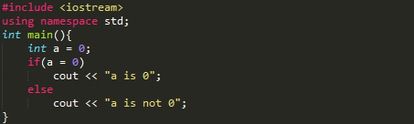
Problem 1
Is there any error in the following program? if no, what is the output? (Try to answer before compiling and running the program.)
<number>

Slide 81
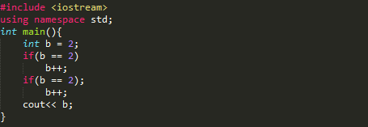
Problem 2
What is the output of this program? Can you explain why?
<number>

Slide 82
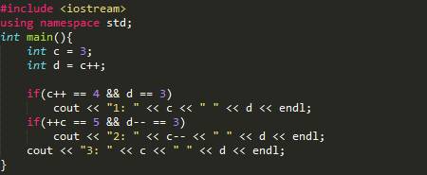
Problem 3
What is the output of this program? (Try to answer before compiling and running the program.)
<number>

Slide 83
Problem 4
Recall that we wrote a program that reads in three integers and outputs the maximum in Module 3. Draw the flowchart for a program that reads in three integers and outputs the minimum.
<number>

Slide 84
Problem 5
Write the corresponding program to the flowchart of problem 4.
<number>

Slide 85
Problem 6
Write a program with an if-else statement that outputs the word High if the value of the variable score is greater than 100 and Low if the value of score is at most 100. The variable score is of type int.
<number>

Slide 86
Problem 7
Write a program to determine the outcome of the paper-rock-scissor game. Each of two users types in either P, R, or S. The program then announces the winner as well as the basis for determining the winner: Paper covers rock, Rock breaks scissors, Scissors cut paper, or Nobody wins. Be sure to allow the users to use lowercase as well as uppercase letters.
<number>

Slide 87
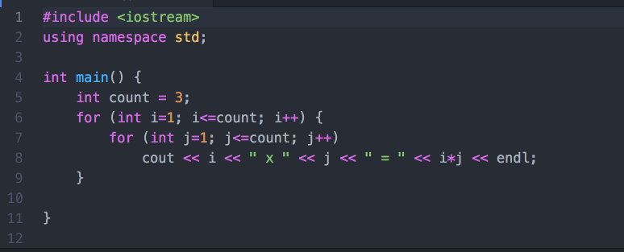
Problem 8
What is the output of the following program? Can you explain the output?
<number>

Slide 88
Problem 9
Write a program that reads in five integers and that outputs the sum of all integers greater than zero, the sum of all the integers less than zero, and the sum of all the integers, whether positive, negative, or zero. The user enters the numbers just once each and the user can enter them in any order. Your program should not ask the user to enter the positive numbers and the negative numbers separately.
<number>

Slide 89
Problem 10
Write a program that will output the following pattern. Use two for loops to achieve the output
0123456 012345 01234 0123 012 01 0
<number>

Slide 90
Problem 11
Write a program with a function that takes one argument of type double. The function returns the character value P if its argument is positive and returns N if its argument is zero or negative. In the main function of your program, call this function to test its behavior.
<number>

Slide 91
Problem 12
Write a program with a function that takes one argument of type int and one argument of type double. The function returns a value of type double that is the average of the two arguments.
<number>
Notes:
<number>

Slide 92
Problem 13
Greek mathematicians took a special interest in numbers that are equal to the sum of their proper divisors (a proper divisor of n is any divisor less than n itself). They called such numbers perfect numbers. For example, 6 is a perfect number because it is the sum of 1, 2, and 3, which are the integers less than 6 that divide evenly into 6. Similarly, 28 is a perfect number because it is the sum of 1, 2, 4, 7, and 14. Write a function that determines if a given number is a perfect number. Your function should take an int as a parameter and return a value of type bool.
<number>
Notes:
<number>

Slide 93
Problem 14
Write a program that finds all the perfect numbers between two limits entered by the user. Use your function from Problem 13.
<number>
Notes:
<number>

Slide 94
Problem 15
A liter is 0.264179 gallons. Write a program that will read in the number of liters of gasoline consumed by the user's car and the number of miles the car delivered, and will then output the number of miles per gallon the car gets. Your program should allow the user to repeat this calculation as many times as the user wishes. Define a function to compute the number of miles per gallon.
Modify your program so that it will take input data for two cars and output the number of miles per gallon delivered by each car. Your program will also announce which car has the best fuel efficiency (highest number of miles per gallon).
<number>
Notes:
<number>

Slide 95
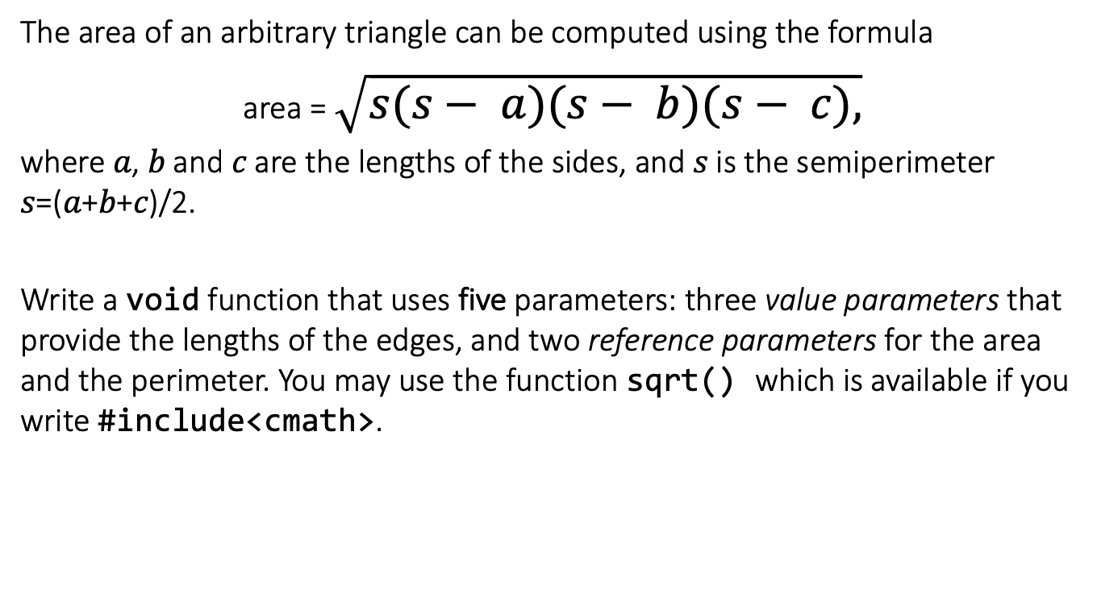
Problem 16
<number>
Notes:
<number>

Slide 96
Problem 17
What is the output of the following program? Explain.
#include <iostream>
using namespace std;
int main()
{
int a = -15, b;
a--;
cout << "a = " << a << endl;
{
int b = 7;
b = 2*a*b;
}
int result = a+b;
cout << "result = " << result << endl;
}
<number>
Notes:
<number>

Slide 97
Optional.
For those who would like to challenge yourselves. Even for those of you who are beginners in C++ programming, it’s highly recommended for you to take a look at these problems and try to tackle them as well.
You are welcome to discuss these problems in the Moodle forum.
CHALLENGES
<number>

Slide 98
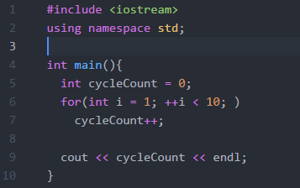
Challenge 1
What will be the output of this program? Or will it loop forever? Try to think about the final value of “cycleCount” before compiling this program.
<number>

Slide 99
Challenge 2
Redo Problem 12. This time, use ONLY one statement in your function to accomplish the same task.
<number>

Slide 100
Challenge 3
Write a program to print the following diamond pattern of ‘*’.
*
***
*****
*******
*****
***
*
<number>

Slide 101
Challenge 4
Write a function which checks if a number is prime or not. (What’s the return type of the function?)
<number>

Slide 102
Challenge 5
Using the function created in Challenge 4, create another function that print all prime numbers p within a given range defined by parameters x, y, where x <= p <= y.
Can you think of a faster implementation of the function?
<number>

Slide 103
Challenge 6
Extend the program you have written for Problem 14, output also whether the perfect numbers found are prime numbers.
<number>

